Slide 1
Fast Weights - The First Transformer Variants?
by Bratan Radu-George and Cristea Eduard Gabriel

Slide 2
Deep Learning
What? A type of machine learning that uses multiple layers to progressively extract high level features from the raw input.
Why? It’s used in image processing such as identifying digits, letters or human faces.

Slide 3
Deep Learning Models
What? Most deep learning models are based on multi-layered artificial neural networks (ANNs) such as CNNs and transformers.
Why? In deep learning, each level learns to transform its input data into a slightly more abstract and generally useful output.

Slide 4
RNNs
What? There are two types of ANNs: feedforward neural networks (FNNs) and recurrent neural networks (RNNs). RNNs have cycles in their connectivity structure, FNNs don’t. RNNs allow the output from some nodes to affect subsequent input to the same nodes.
Why? Their ability to use memory to process random sequences of inputs makes them useful to tasks such as speech or text recognition.

Slide 5
Fast Weights
What? An alternative to RNNs published by Jürgen Schmidhuber in 1992 (an early version of Transformers).
Why? Storage efficiency: a simple weight (instead of a full-fledged memory unit that RNNs use) may be sufficient for storing temporal information.

Slide 6
Fast Weights Explained
What? A concept aimed at mimicking the human brain’s ability to rapidly learn new information without forgetting previously learned information.
Why? Traditional neural networks struggle with this because of the stability-plasticity dilemma, where they need to be plastic (or adaptable) enough to learn new things but stable enough not to forget old knowledge - a problem often referred to as catastrophic forgetting.

Slide 7
“Weights”
What? “Weights” are the parameters that adjust during training to help the network make accurate predictions.
In a normal neural network, these changes in weights occur relatively slowly as the result of an iterative process over many epochs to ensure learning from the entire dataset.

Slide 8
“Fast Weights”
What? “Fast weights” introduces a second set of weights that can change rapidly in response to the most recent data, aside from the regular “slow” weights.
Therefore, a neural network with fast weights has slow weights that learn the general structure in the data over longer periods, and fast weights that rapidly adapt based on the latest data points.

Slide 9
Fast Weights (Technical)
How? Fast weights consist of two feed-forward nets which learn to deal with temporal sequences by using fast weights: the first net learns to produce context dependent weight changes for the second net, whose weights may vary very quickly.

Slide 10
Our approach
What? We implemented a model using Transformers in hopes of replicating the results of the fast weights approach (because fast weights are basically the modern-day transformers).
We also created an abstract implementation of a custom fast weights model that doesn’t actually run, for the purpose of exemplification.

Slide 11
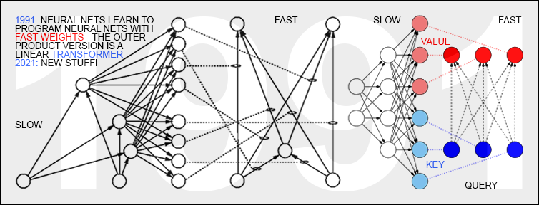

Slide 12
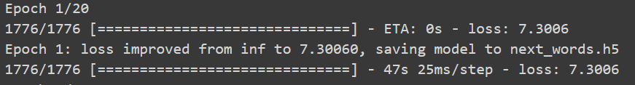
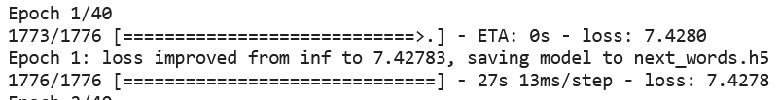

Slide 13
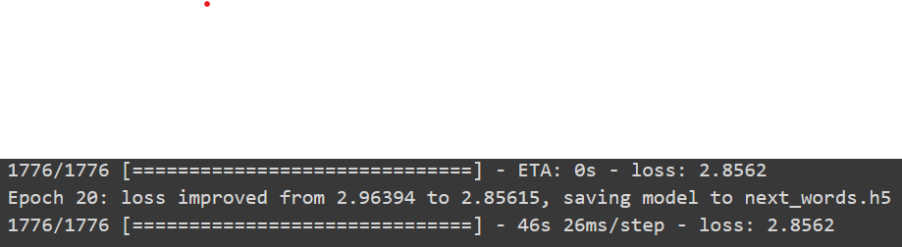
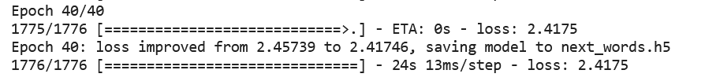

Slide 14
